Slide 1

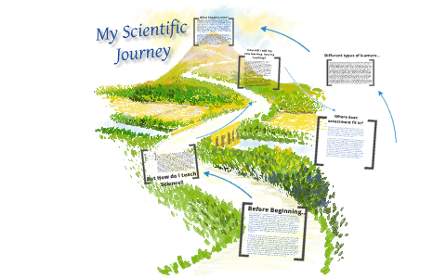
Hello,
I’m Bernice
First born in a family of five,
Am a daughter, sister, wife, mom, aunt and a grandma already 😜 😊
Life-long student
Post graduate Student, John Innes Center, UK

Slide 2
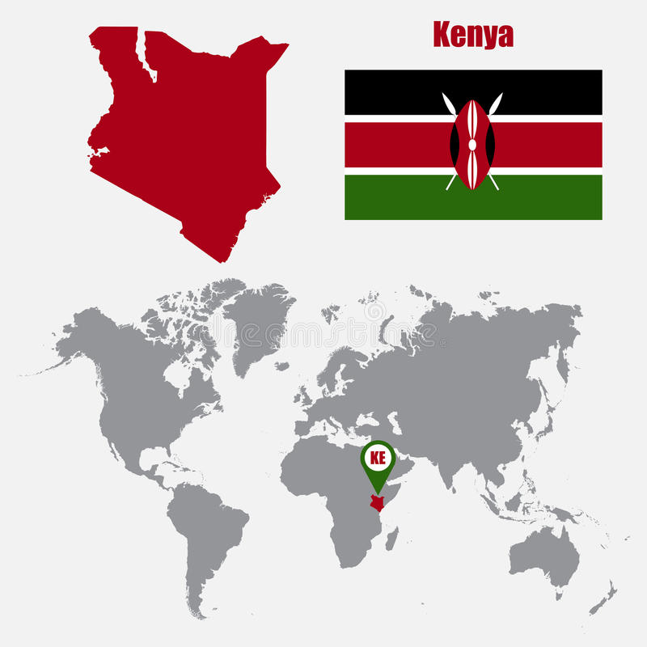

I am from
Kenya

Slide 3
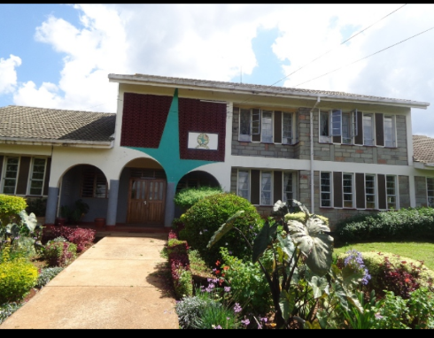

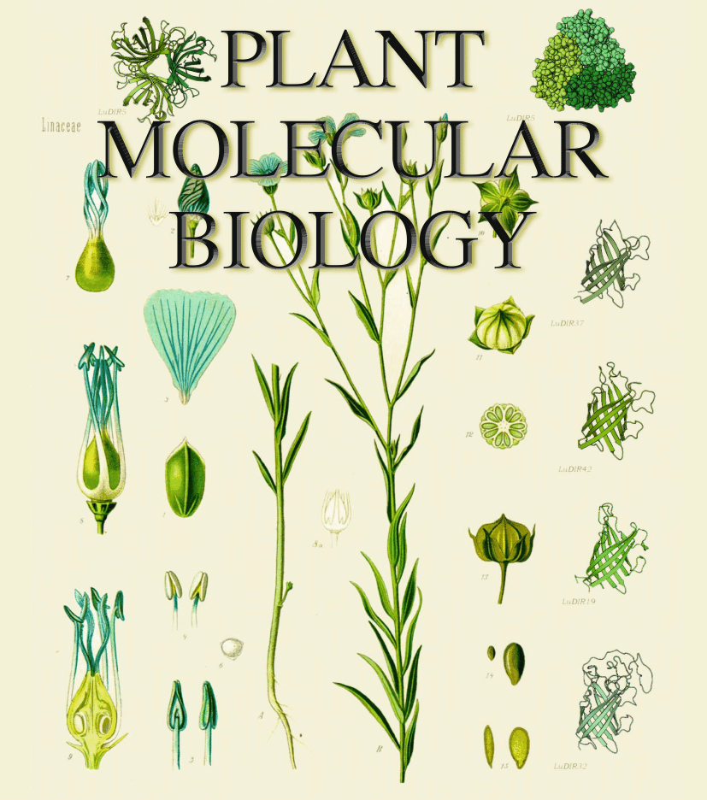



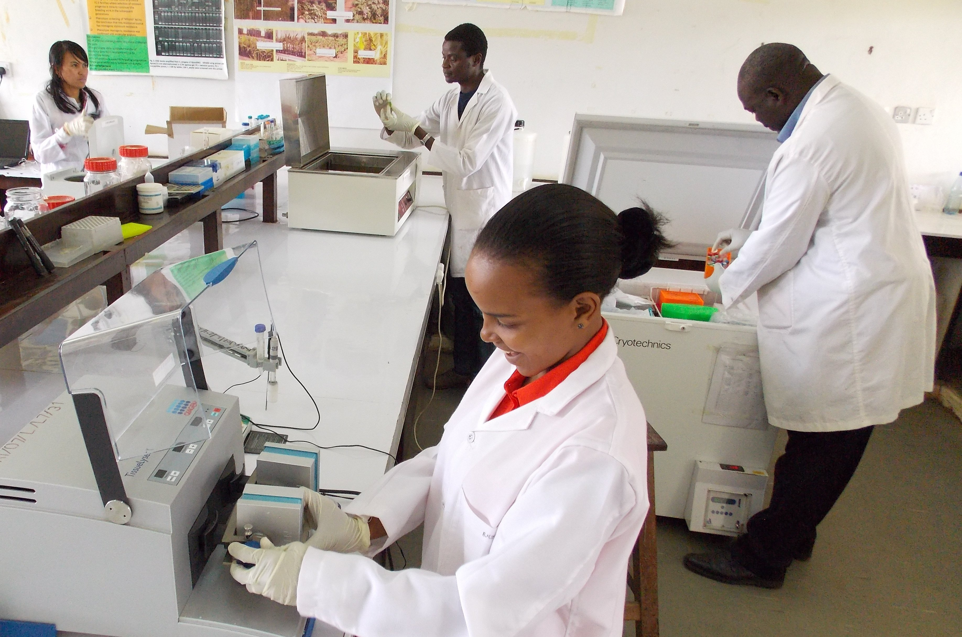
Secondary 2001 - 2005
Moi Tea Girls High School,
Kericho, Kenya
Undergraduate 2006 - 2010
BSc. in Biomedical Sciences and Technology
Egerton University, Njoro, Nakuru, Kenya
KALRO Njoro – Industrial Attachment - 2009
- Research Assistant – 2010
- Graduate Research Assistant – wheat programme

Slide 4
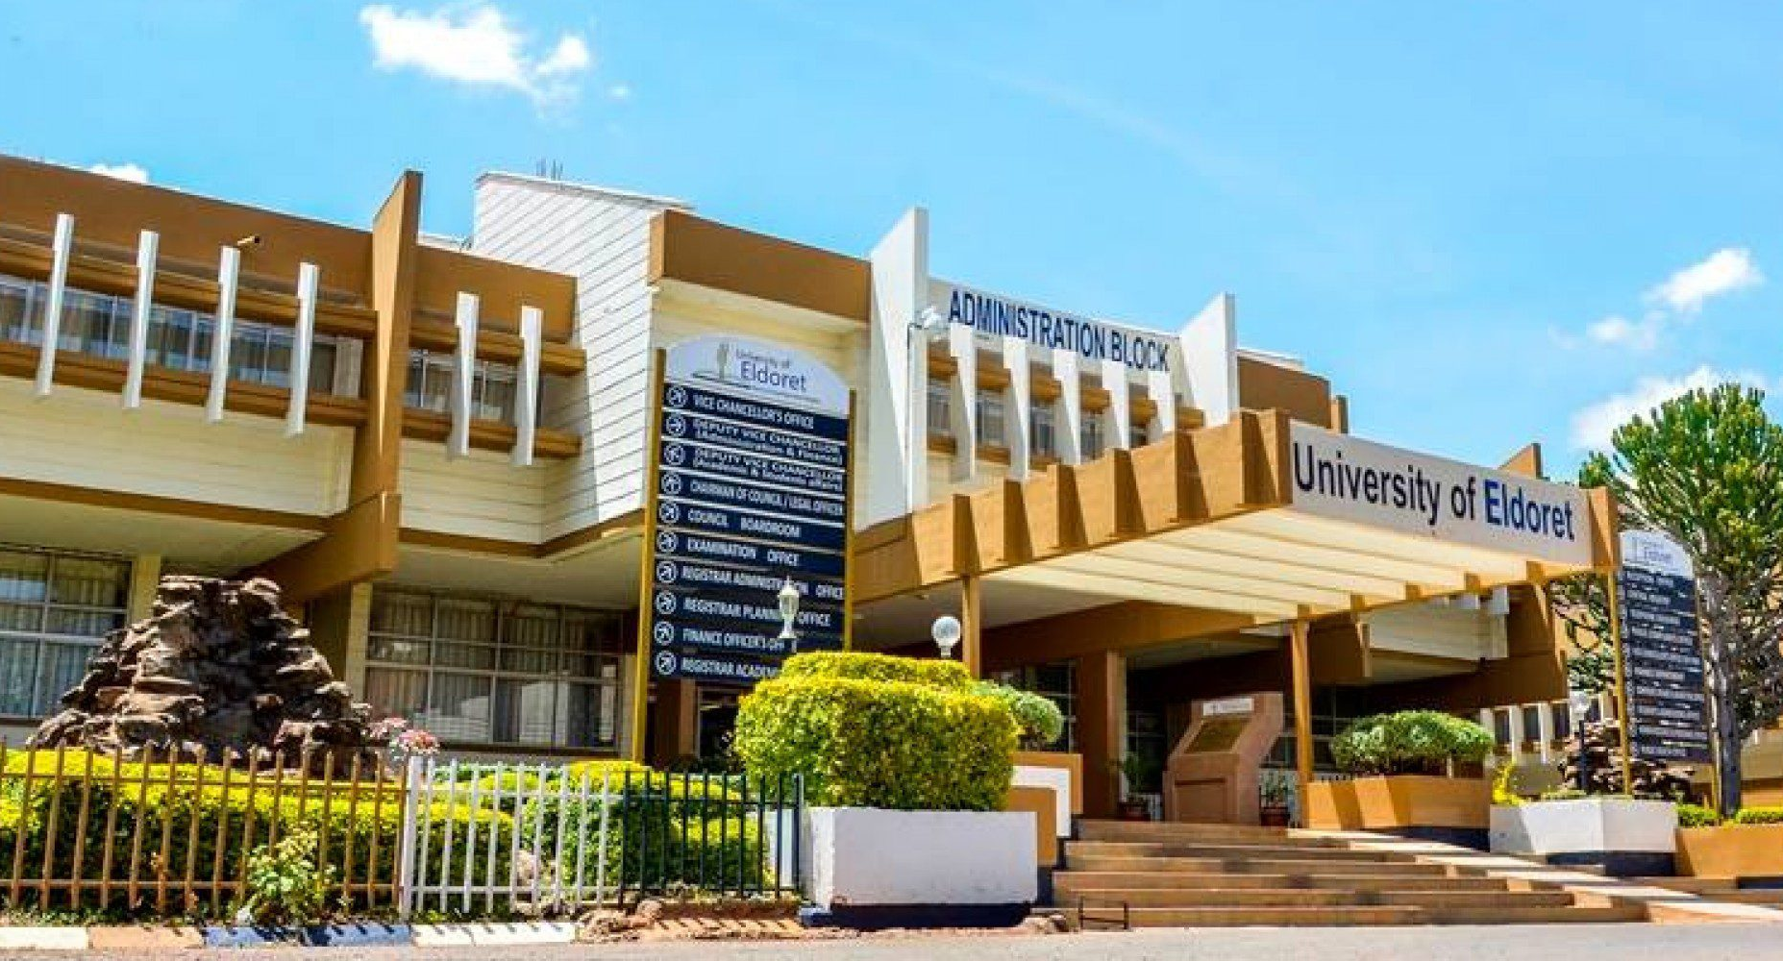
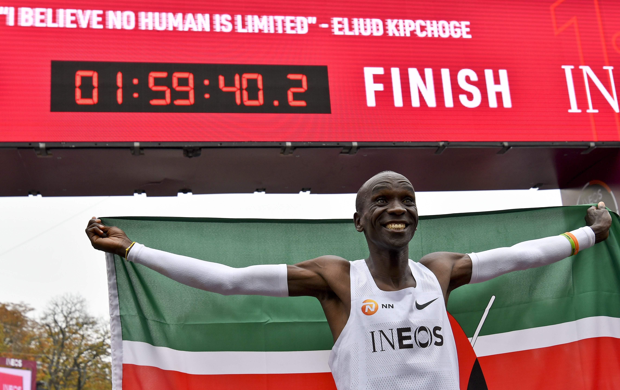
Secondary 2001 - 2005
Moi Tea Girls High School,
Kericho, Kenya
Undergraduate 2006 - 2010
BSc. in Biomedical Sciences and Technology
Egerton University, Njoro, Nakuru, Kenya
Masters 2014 - 2018
MSc. in Plant Breeding and Biotechnology
University of Eldoret, Eldoret, Kenya

Slide 5


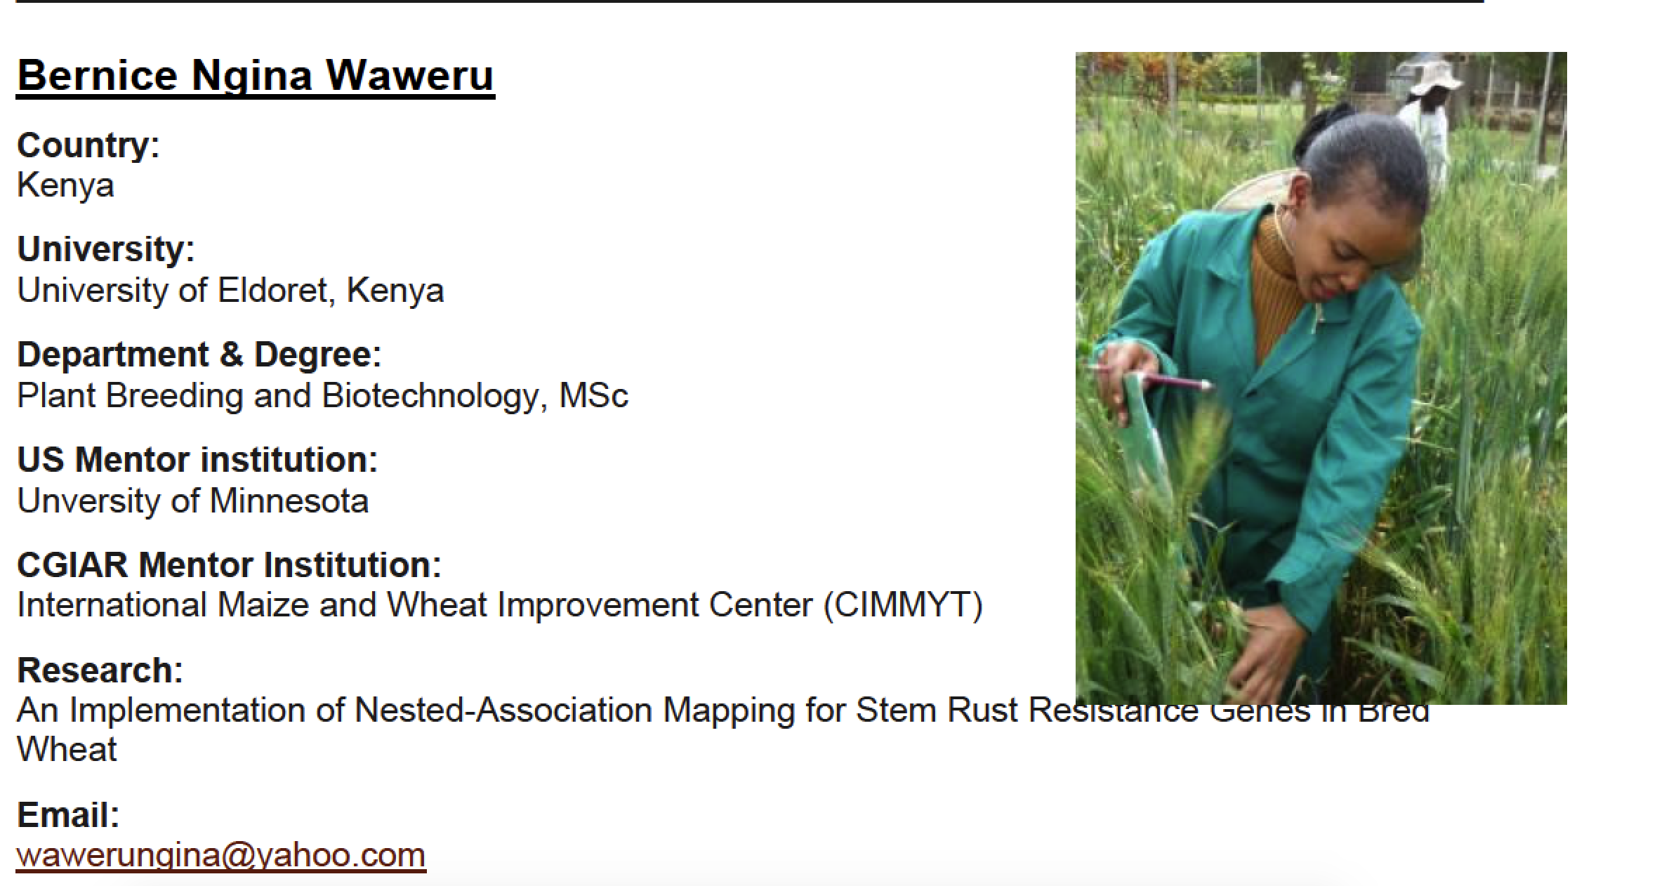
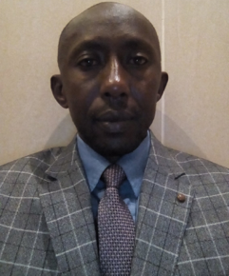
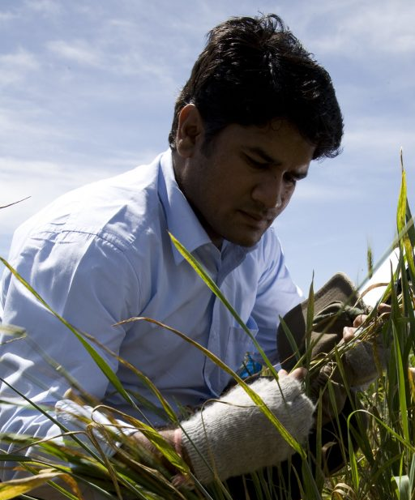
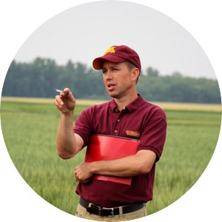
Dr. Godwin Macharia KALRO Njoro Director
Dr. Sridhar Bhavani
Wheat Molecular Breeding CIMMYT
Prof. Jim Anderson Uni. Minnesota
Wheat, Intermediate wheat grass

Slide 6
MSc. Research: Quantitative trait loci mapping for adult plant resistance to stem rust in bread wheat cultivar ‘Akuri’
Linkage groups showing significant QTL for Stem rust with corresponding LOD contours obtained from CIM. The LOD significance threshold of 2.5 is indicated by a dashed line

Slide 7
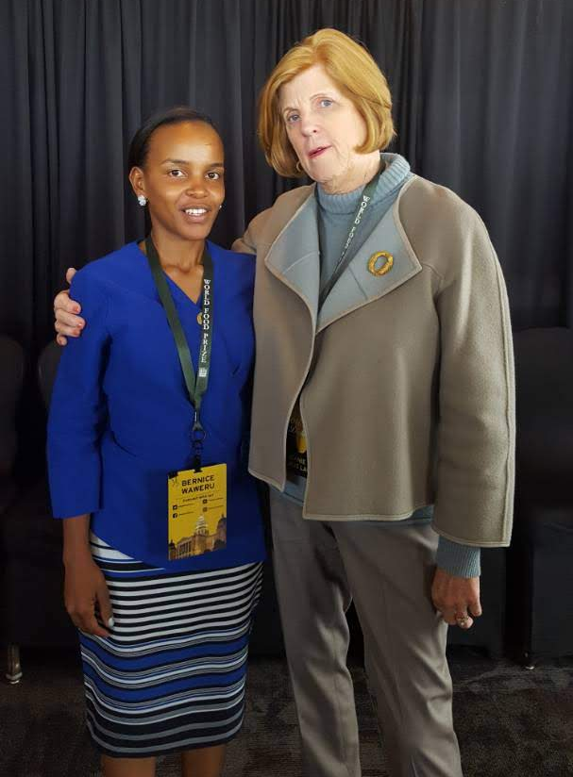
World Food Prize, Des moines, Iowa, USA 2014, 2017

Slide 8
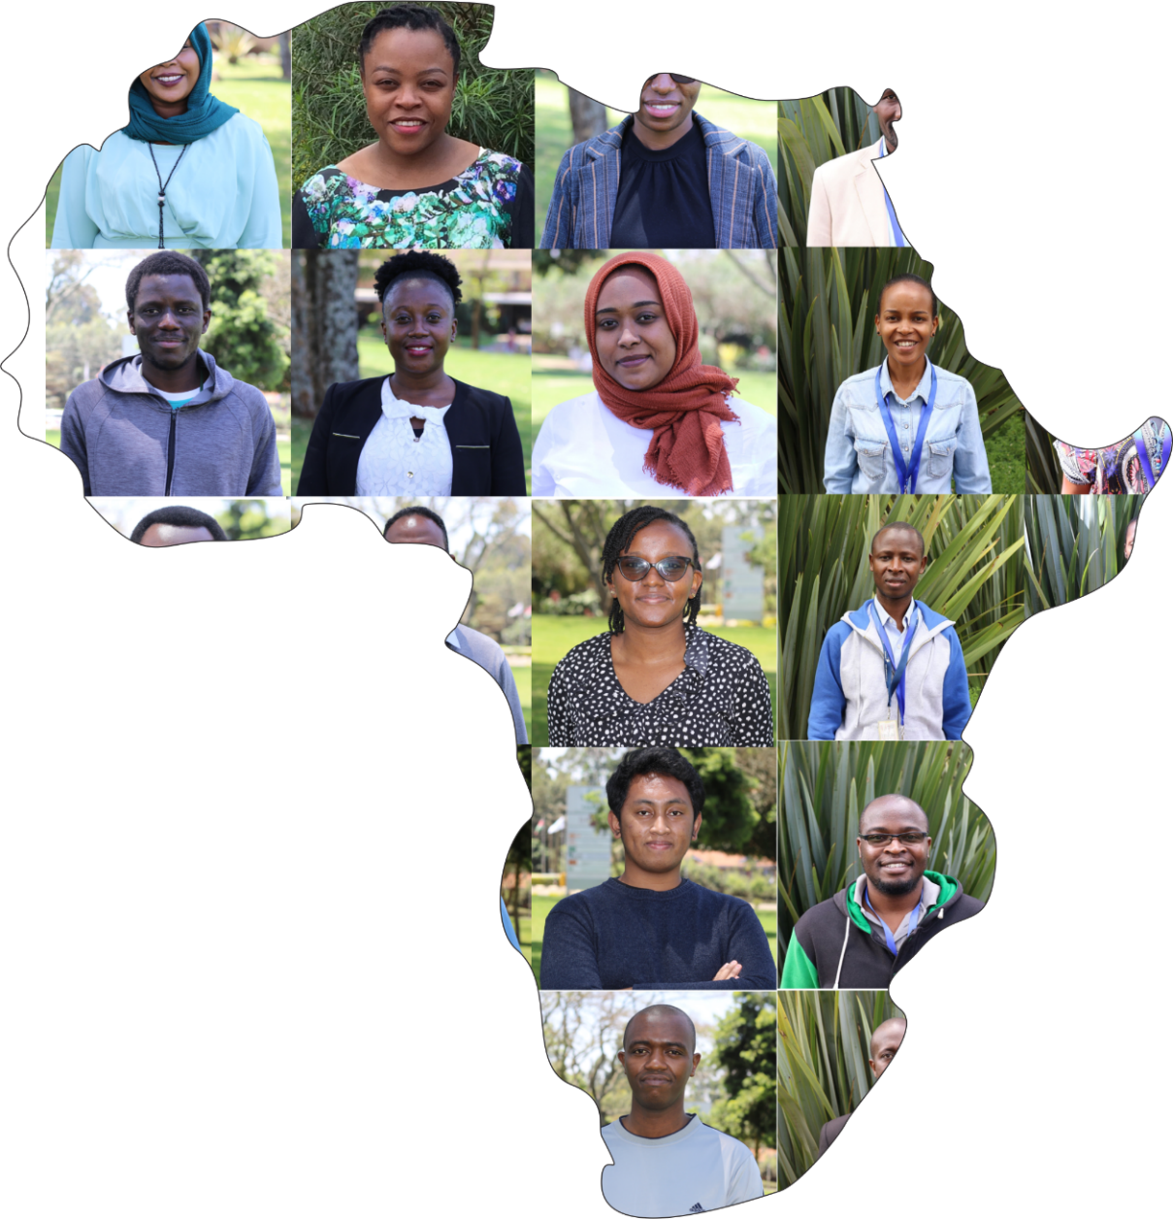
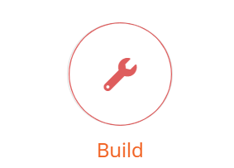
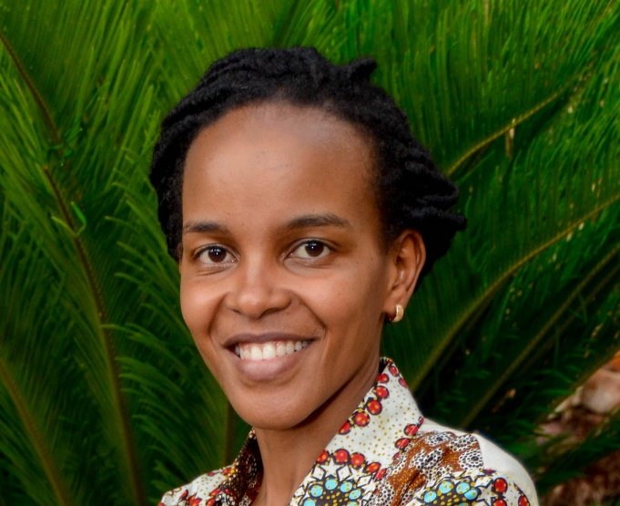

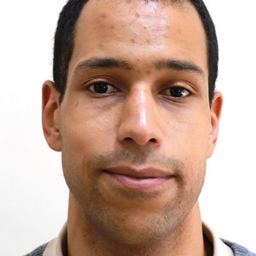
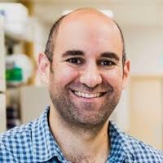

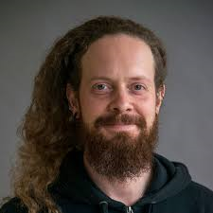

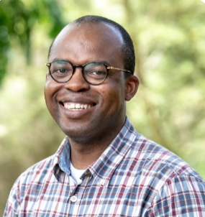
Community-focused capacity building initiative
Bioinformatics Community of Practice (BiXCOP)
Bernice Waweru
from KALRO-Kenya
Bioinformatician, ILRI
Capacity building
Jean-baka
Domelevo Entfellner
Cristobal Uauy
Oluwaseyi Shorinola
Rob Davey
Peter Emmrich
Notes:
To build the capacity of local researchers to handle genomic data,
A community-focused more in-depth capacity building initiative dubbed the Bioinformatics community of practice was established in 2018, a collaboration by the BecA-ILRI Hub Kenya, John Innes Centre and Earlham institute in UK and later also Oxford nanopore technologies to train local researchers from various Sub-Saharan African countries coming from different institutions, including universities and NARs.
The initiative, unlike other short cursory training models, focusses on more in-depth training of local early career researchers.
The main motto has been to train the few that can go on to train many others so that through encouraging peer learning, we can develop a community of practice for genomics that is self sustaining.

Slide 9
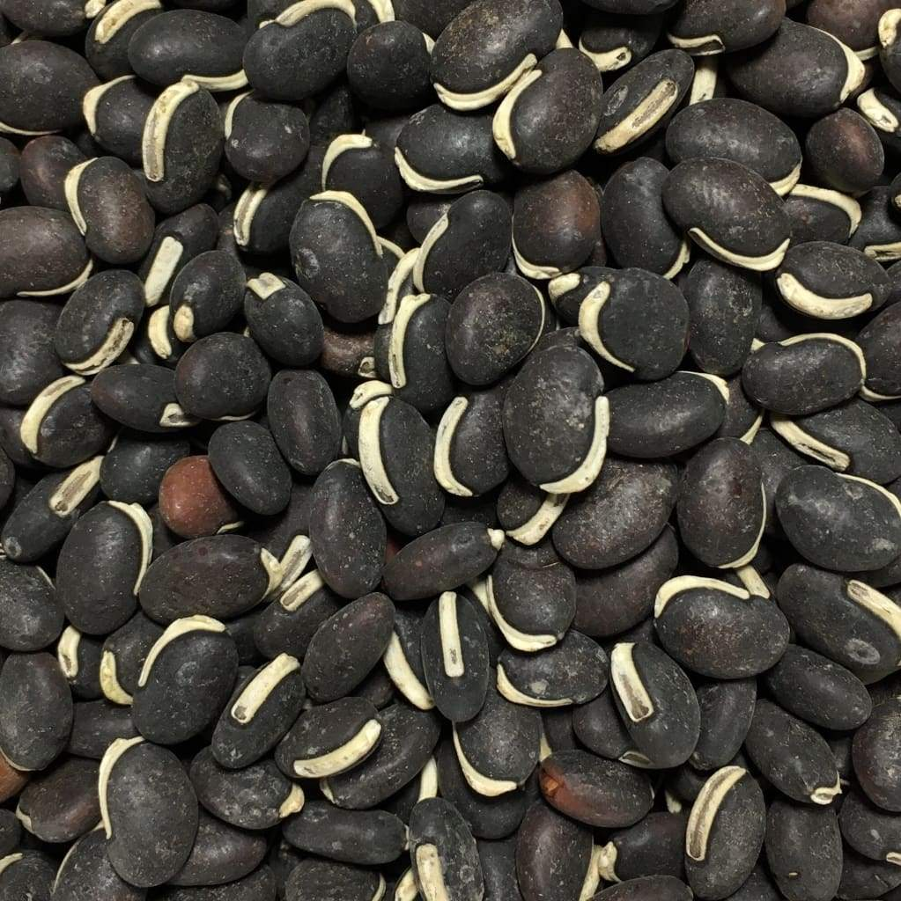
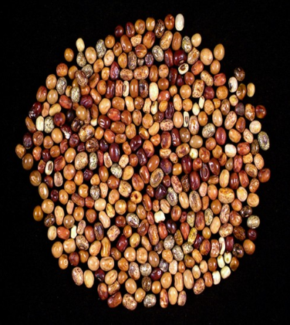
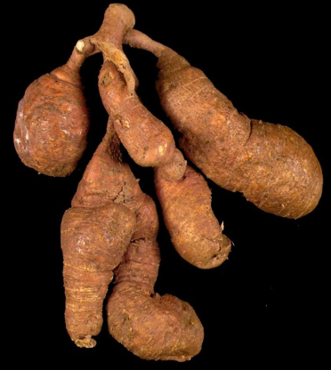



African-Led Genome Sequencing of Lablab and African Yam Bean
Orphan Crop Genomes

Slide 10
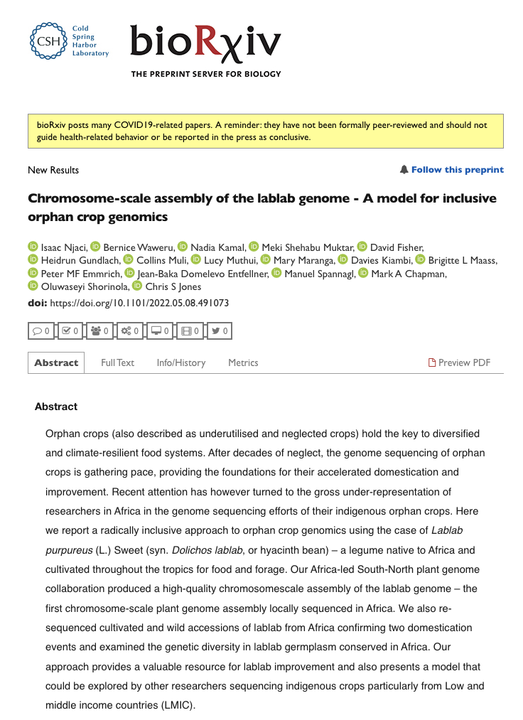
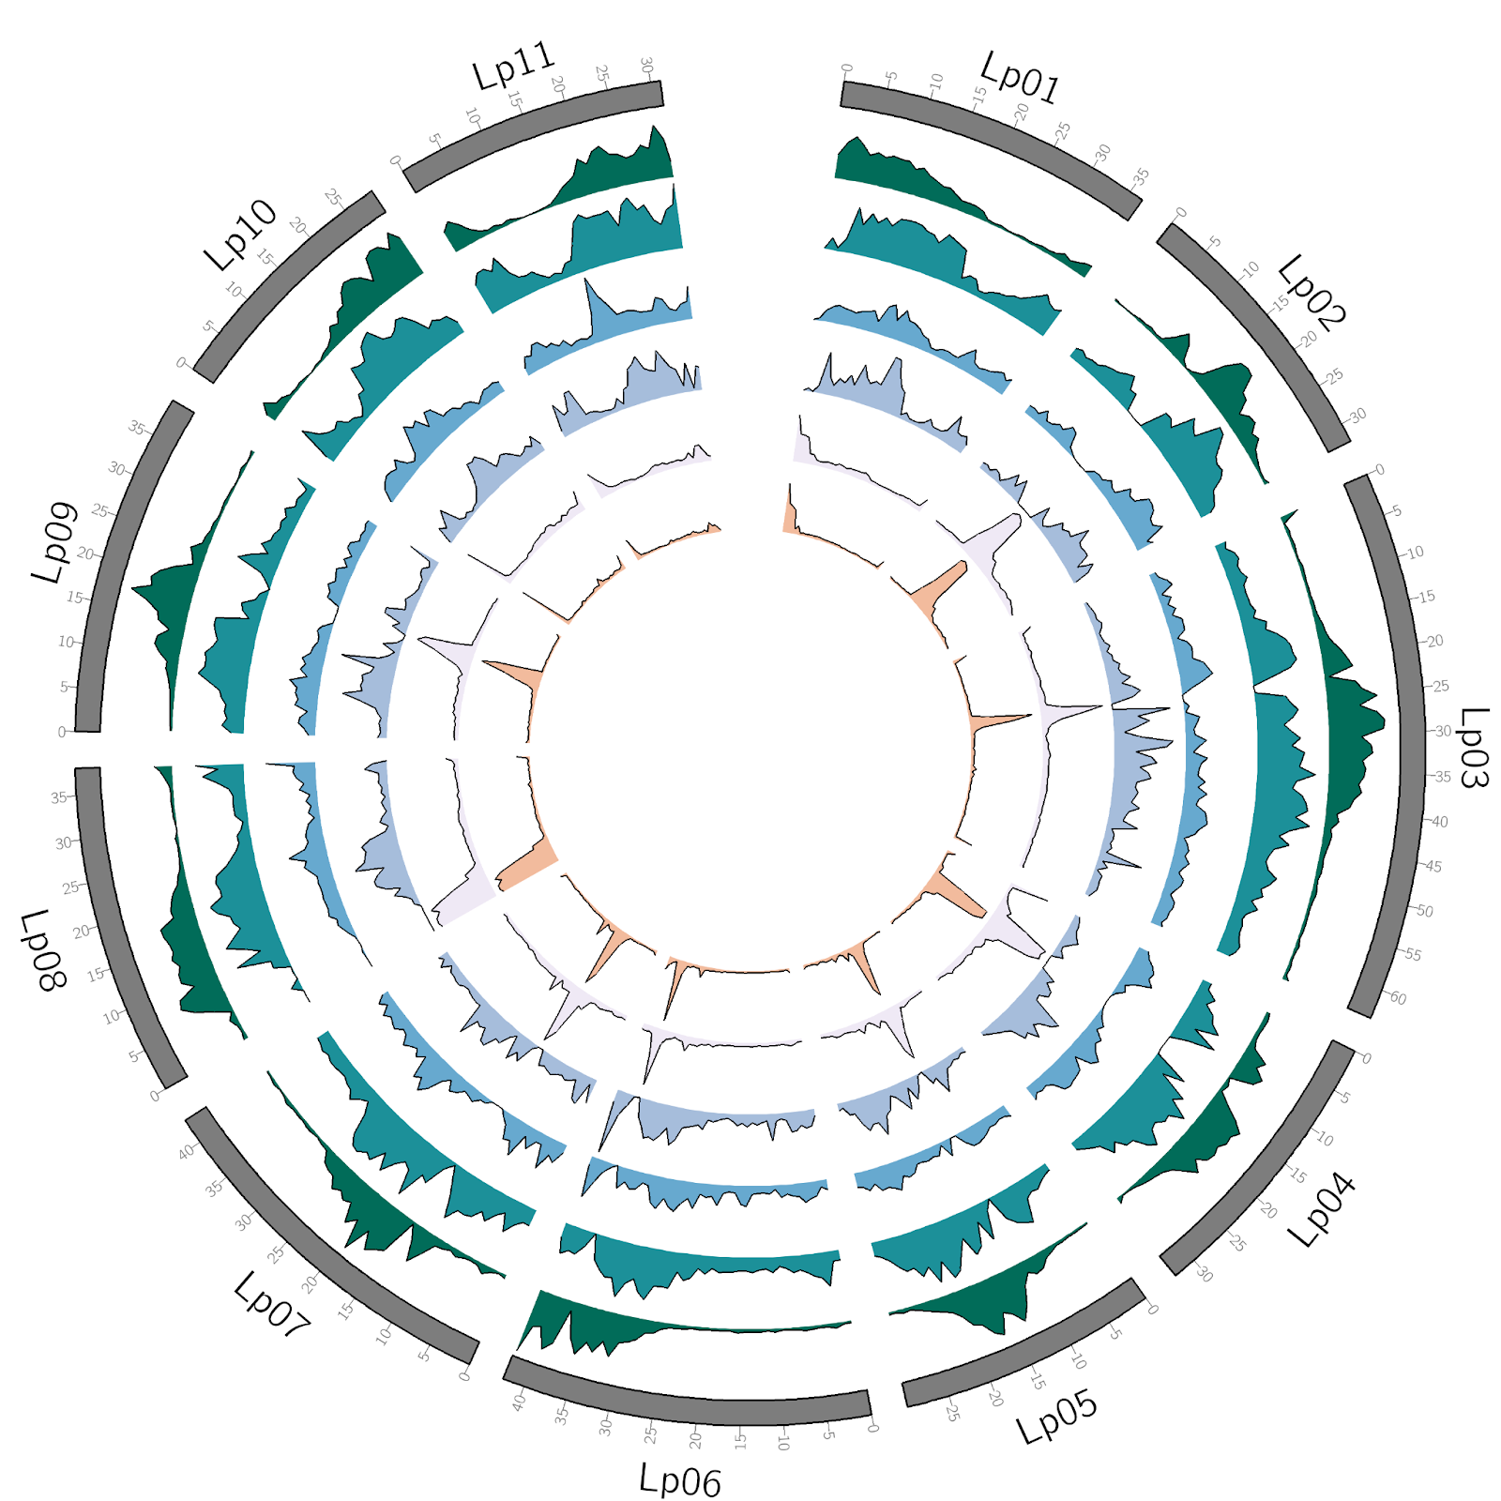

Slide 11

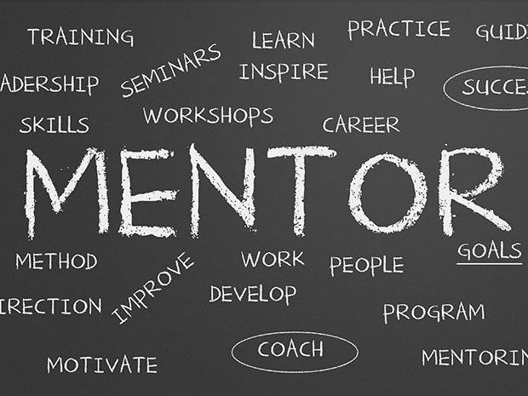


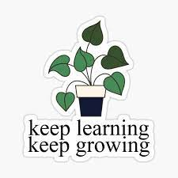



Key Lessons

Slide 12

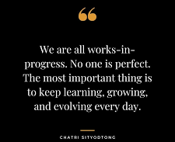
Don’t take on too much

Slide 13


https://www.linkedin.com/in/bernice-waweru-genetics-genomics-bioinformatics/
@bnwaweru

